Slide 1
Quantum Information
Processing
Dr. Moshiur Rahman
Stevens Institute of Technology

Slide 2
Review of Boolean Algebra
A proposition can be true or false, but not both.
We use 1 to represent true and 0 to represent false.
We use logic connectives to combine propositions.
AND, OR, XOR, & NOT are boolean functions to map propositions.
AND
X₁ X₂ Y₁
0 0 0
0 1 0
1 0 0
1 1 1
OR
X₁ X₂ Y₁
0 0 0
0 1 1
1 0 1
1 1 1
XOR
X₁ X₂ Y₁
0 0 0
0 1 1
1 0 1
1 1 0
NOT
X₁ Y₁
0 1
1 0

Slide 3
Review of Boolean Algebra
Each boolean function has n input variables and maps it to m output variables.
Since each variable can be a 0 or a 1, the function can have 2^{n} inputs.
A series of functions can be applied to create new functions.
For example: AND followed by NOT, denoted as NAND.
NAND
X₁ X₂ Y₁
0 0 1
0 1 1
1 0 1
1 1 0
NOR
X₁ X₂ Y₁
0 0 1
0 1 0
1 0 0
1 1 0

Slide 4
Universal Set of Gates
Elements of a finite set of boolean functions are called Gates.
A set of gates is considered universal if every boolean function can be implemented as a combination of gates.
The three gates NAND, NOR, and AND-XOR form a universal set in classical computing.
Every single boolean function of any size can be represented as a sequence of these three gates.
This idea of a universal set will later be applied to Quantum Computing.

Slide 5
Quantum Information
The fundamental unit of data in classical computing is a bit.
The fundamental unit of data in quantum computing is a qubit.
Since qubits can exist in more than one state at a time, they can be manipulated simultaneously.
In quantum computing, we have |0⟩ and |1⟩ to represent the two states of a boolean.

Slide 6
The Qubit and Its Representations
A qubit can be represented by any 2 level quantum system, here are a few:
An electron in a hydrogen atom using the ground and excited states.
A photon’s horizontal and vertical polarization.
Current in superconductors.
Ground State |0⟩
Excited State |1⟩

Slide 7
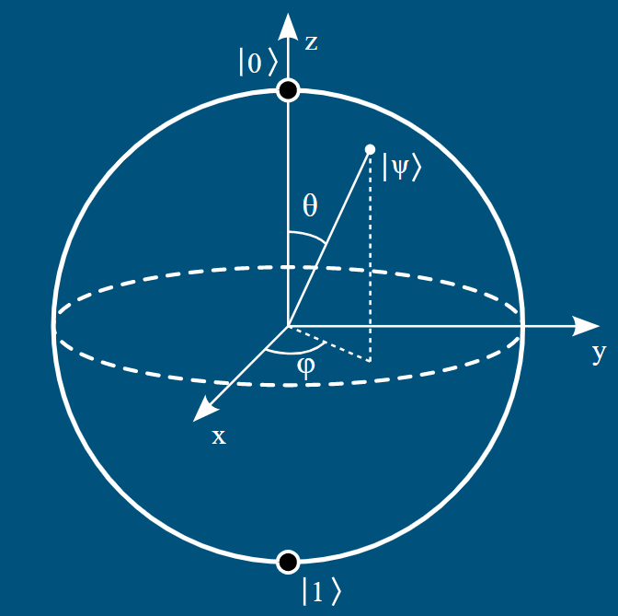
The Visual Representation
The Bloch Sphere is a visualization of a qubit.
It is a unit sphere centered at the origin.
All valid qubit states are on the surface of the sphere.
The poles are |0⟩ and |1⟩.
All other states are superpositions of |0⟩ and |1⟩.
The equator is equal probability, like when created by the Beam Splitter.

Slide 8
The Visual Representation
We can get the general form of a qubit using spherical coordinates.
|ψ⟩ = cos(θ/2) |0⟩ + e^{iϕ} sin(θ/2) |1⟩
Where 0 ≤ θ ≤ π and 0 ≤ ϕ < 2π.
Since the radius of the sphere is 1 we see
| cos(θ/2) |² + | sin(θ/2) |² = 1
Which is where the probability amplitudes are seen
| α |² + | β |² = 1

Slide 9
The Visual Representation
From the Bloch Sphere representation we see:
|ψ⟩ = |0⟩ when θ = 0 and |ψ⟩ = |1⟩ when θ = π
The trigonometric functions come from not only the sphere, but also the wave nature of subatomic particles.
The phase, ϕ, does not affect the probabilities directly. It still plays an important role in computation.

Slide 10
The Visual Representation
The six major states of the Bloch Sphere are:
Positive Z Negative Z
|0⟩ = |0⟩ |1⟩ = |1⟩
Positive X Negative X
|+⟩ = |0⟩ + |1⟩ |-⟩ = |0⟩ - |1⟩
√2 √2
Positive Y Negative Y
|i⟩ = |0⟩ + i|1⟩ |-i⟩ = |0⟩ - i|1⟩
√2 √2

Slide 11



The Vector Representation
The vectors |0⟩ and |1⟩ are orthogonal, represented by
Which means any arbitrary qubit state is represented by the vector

Slide 12
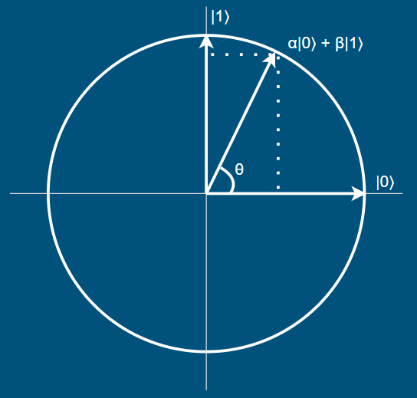
The Vector Representation
Since |0⟩ and |1⟩ are orthogonal, they are the basis states.
We can look at the circle formed by the linear
combination of basis vectors.
If we ignore the phase, this representation is
topologically equivalent to the Bloch Sphere*.
The projection of this vector onto the horizontal and vertical axises are the amplitudes, α & β.
*It is important not to confuse this circle with the Bloch Sphere

Slide 13
Superposition in Quantum Systems
A clear advantage of quantum computing is a single operation affects both of the basis states because of superposition.
It is possible to store a vast amount of information on a single qubit.
However, it is impossible to retrieve it.
When a qubit is measured, it collapses into a boolean, losing almost all of the information about the probabilities and phase.

Slide 14
Multi-Qubit Register
A quantum register contains n qubits which means there are 2^{n} states.
For a register of size 4 there are 16 states: 0000, 0001, 0010, 0011, ... 1111.
Thus, a 4 qubit register can be represented in a superposition of 16 states:
|ψ⟩ = c₀|0000⟩ + c₁|0001⟩ + c₂|0010⟩ + c₃|0011⟩ + … + c₁₅|1111⟩
where they have complex amplitudes such that
| c₀ |² + | c₁ |² + | c₂ |² + | c₃ |² + … + | c₁₅ |² = 1
This increased state space allows for parallel processing to solve certain problems much faster than classical computers.

